Slide 1

Data Shape & Distribution
33

Slide 2
Data Shape and Distribution
Essential for understanding how data behaves
Helps decide appropriate data transformations
Crucial for model selection and predictions
Influences outlier detection and risk assessment
Application: Helps improve model accuracy by tailoring analysis to the data's distribution
34

Slide 3
Data Shape and Distribution
Skewness: Direction of data asymmetry
Kurtosis: Data peakedness
35

Slide 4
Skewness:
Measures the asymmetry of a dataset’s distribution
Application in Data Science: Helps assess data symmetry and decide the type of model to use
Example:
Housing prices: $50K, $150K, $200K, $1M
Positive skew (right tail): A few extremely high property prices
Why It’s Important: Identifies the need for data transformation or special handling before analysis
36

Slide 5
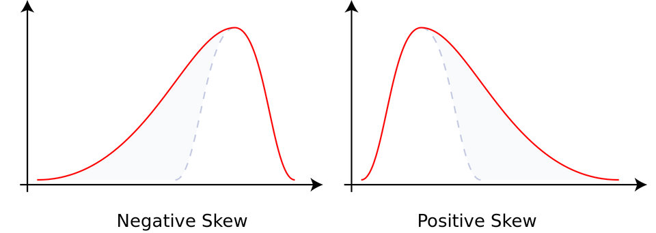
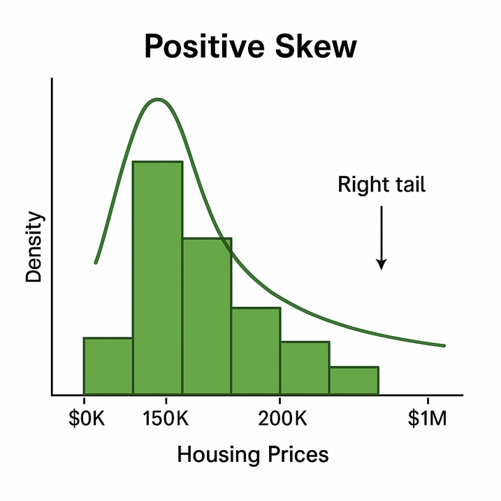
Skewness
Measures data asymmetry
Types:
Positive Skew: Right tail longer
Negative Skew: Left tail longer
Using the example of housing prices
37

Slide 6
Kurtosis:
Measures the 'tailedness' or concentration of data
Application in Data Science: Helps detect outliers and understand the risk in data distributions
Example:
Stock returns: 5%, -2%, 10%, 3%, 30%
High kurtosis (heavy tails): A few extreme values outside the usual range
Why It’s Important: Essential for risk assessment, portfolio management, and handling extreme data points in models
38

Slide 7
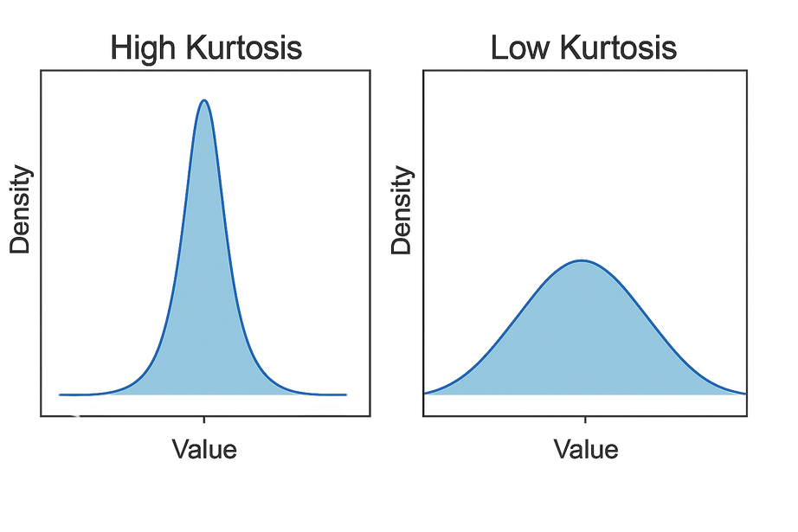
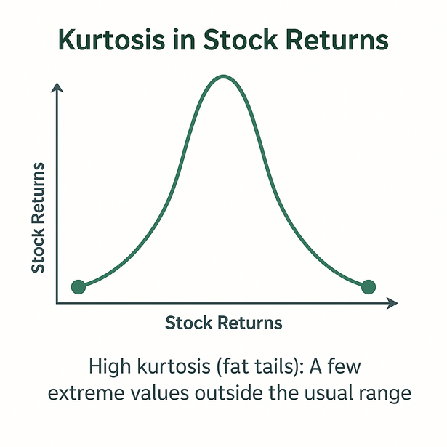
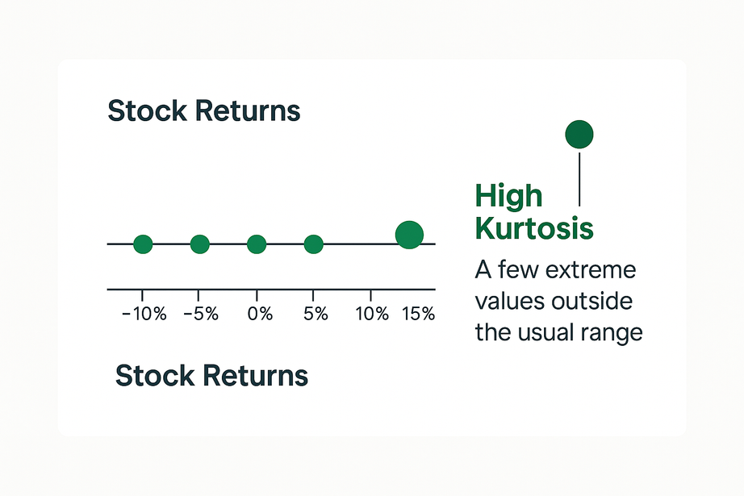
Kurtosis
Measures data peakedness
Types:
High Kurtosis: Sharp peak, heavy tails
Low Kurtosis: Flattened distribution
39

